Slide 1
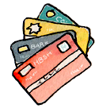
Interest and Credit

Slide 2
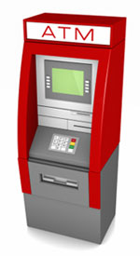
Word Bank
Principal
Budget
Deposit
Finance Charge
ATM
Register/Ledger
Debit Card
Balance
Credit Report
Interest (good/bad)

Slide 3
Bank Loans
$ into a savings account=bank pays you interest (good)
$ that is borrowed from a bank=you pay the bank interest (good/bad)
Formula to calculate interest:
Interest=Principal x Rate x Time
(I=PRT)

Slide 4
Borrow Money (Loan) with Interest
New Car -$20,000
Down Payment-$2,000 __________________________________
Rate- 12%
Time-Pay back in 5 years
How much interest? ______________________________________
Total when you pay off the loan= ____________________________________________

Slide 5
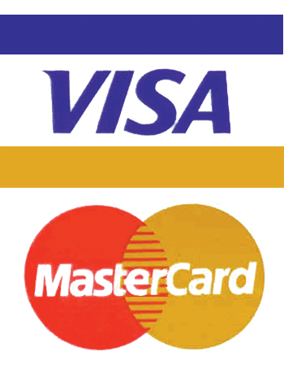
Credit Cards
Pros: Buy merchandise without cash
Cons: Paying more for the purchase because of finance charges (APR)
Ex:
Purchase a new computer with a credit card-$1,299
Minimum Balance Due per month-$216.50
Finance Charge (APR) 18% (over the course of the time frame)
6 mon to pay off
a) Finance amount per month _______________________
b) Total Amount Paid after 6 months _____________

